Slide 1
Dumpster, Latrine, & Hand Wash Station Request
Update below slides or add slides as needed to identify location and number of portable latrines or hand wash stations needed.
All BIV Sites have predetermined locations for dumpsters with the exception of the COL Site and SIM Center Biv Site.
Add additional slides for areas other than Biv Sites, COL Site, and SIM Center Biv Site.
For questions contact WHFRTC Logistics.
Request should include this overview and the spreadsheet titled “WHFRTC Latrine_Dumpster_Ice Request”
Email request to GTC Logistics support: ng.ky.kyarng.list.whfrtc-logistics@mail.mil

Slide 2
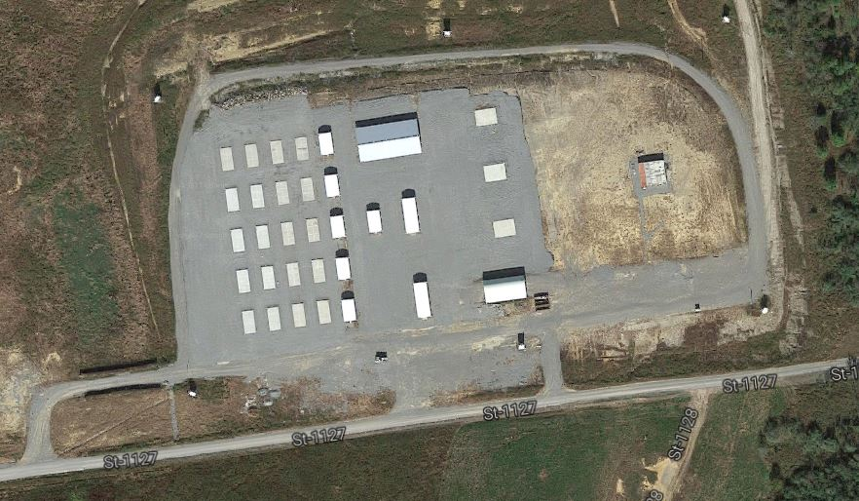
COL SITE
Recycling Trailer
Latrines (#)
Dumpster
Hand Wash (#)

Slide 3
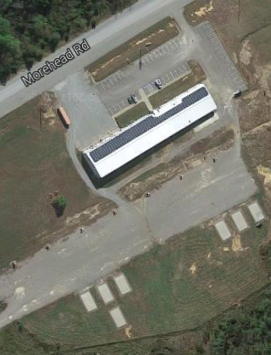
SIM CENTER BIV SITE
Latrines (#)
Dumpster
#
#
#
Recycling Trailer
CP
BN CP
CP
HHC
CK
COOKS
SLEEP
FIELD
SANITATION
Hand Wash (#)
DISTRO
CP
FMC

